Slide 1
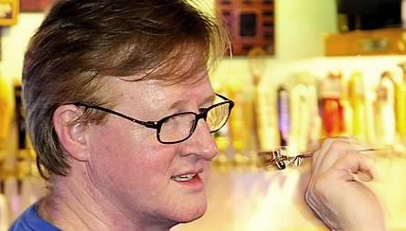
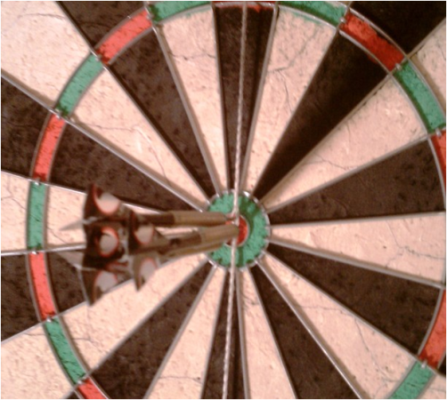
DartSight
DartSight

Slide 2
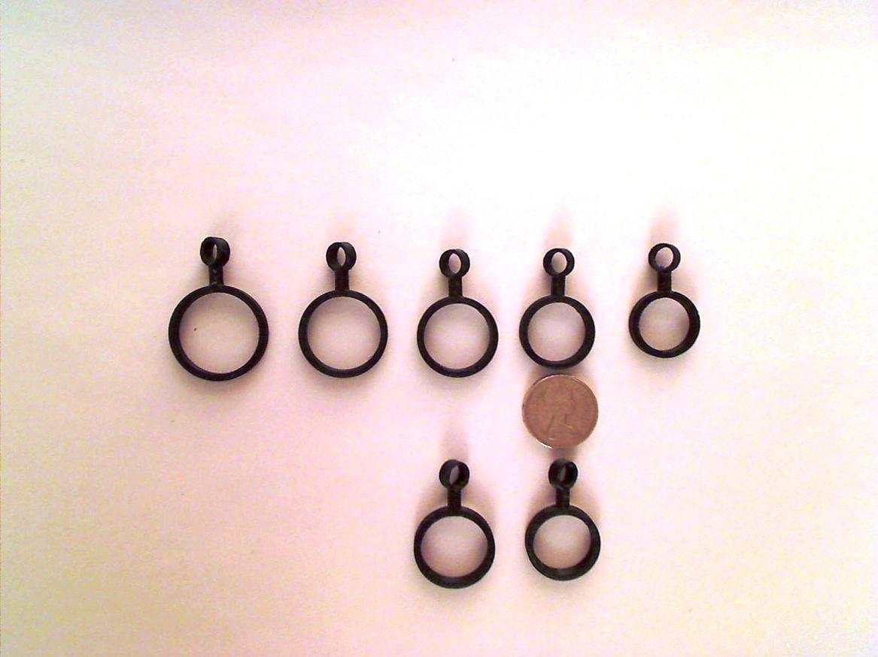
XXLarge RH
XLarge RH
Large RH
Medium RH
Small RH
Course Enhancement ProjectCourse Enhancement ProjectCourse Enhancement ProjectCourse Enhancement ProjectCourse Enhancement ProjectCourse Enhancement ProjectCourse Enhancement ProjectCourse Enhancement ProjectCourse Enhancement ProjectCourse Enhancement ProjectCourse Enhancement ProjectCourse Enhancement ProjectCourse Enhancement ProjectCourse Enhancement ProjectCourse Enhancement ProjectCourse Enhancement ProjectCourse Enhancement ProjectCourse Enhancement ProjectCourse Enhancement ProjectCourse Enhancement ProjectCourse Enhancement ProjectCourse Enhancement ProjectCourse Enhancement ProjectCourse Enhancement ProjectCourse Enhancement ProjectCourse Enhancement ProjectCourse Enhancement ProjectCourse Enhancement ProjectCourse Enhancement ProjectCourse Enhancement ProjectCourse Enhancement ProjectCourse Enhancement ProjectCourse Enhancement ProjectCourse Enhancement ProjectCourse Enhancement Project
1 pound coin
Large LH
Medium LH

Slide 3
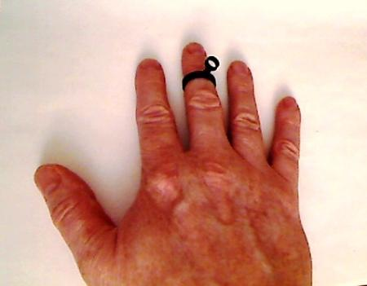
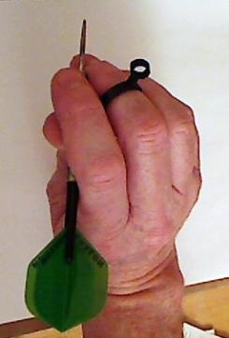
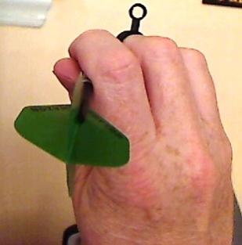
DartSight

Slide 4

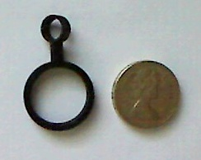
DartSight

Slide 5

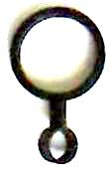
DartSight
DartSight

Slide 6
DartSight

Slide 7
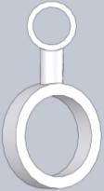
DartSight
MEDIUM: 18mm diameter RH
www.dartsight.com

Slide 8
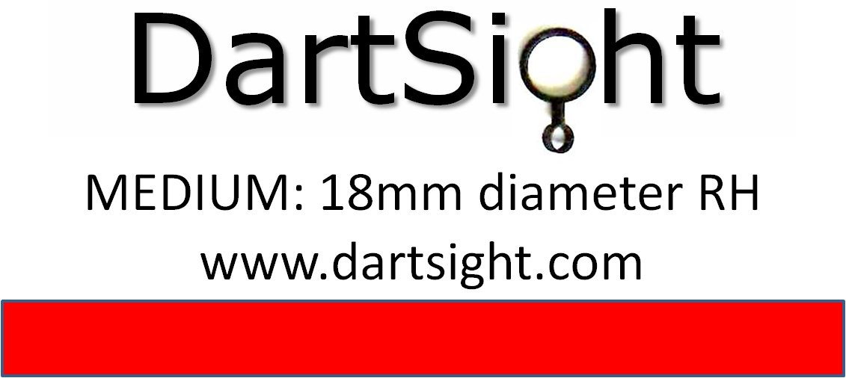

Slide 9
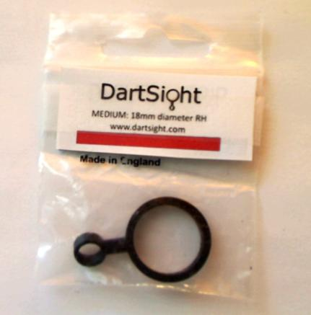

Slide 10
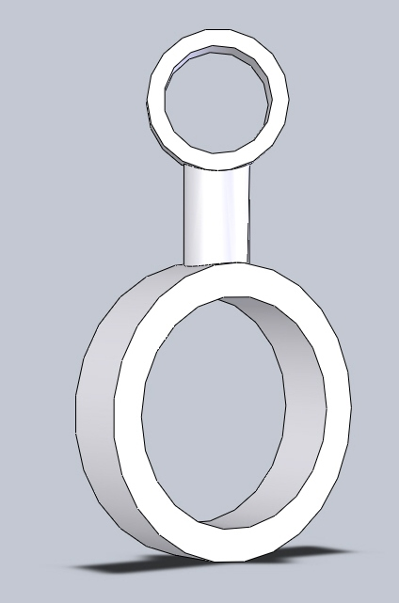
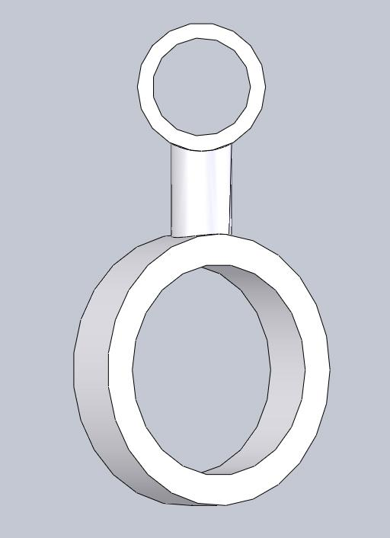

Slide 11
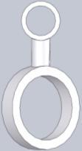
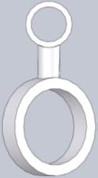

DartSight
DartSight

Slide 12



DartSight
Helps to develop a more consistent level of accuracy
On a more regular basis

Slide 14
www.DartSight.com

Slide 15


